Slide 1


Slide 2
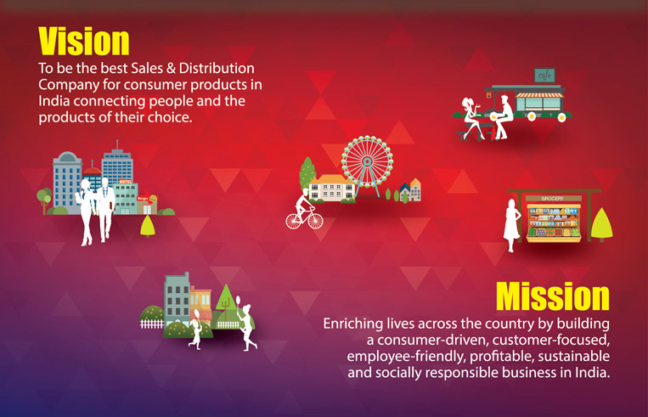
Coca cola’s vision and mission
https://www.coca-colacompany.com/our-company/mission-vision-values

Slide 3
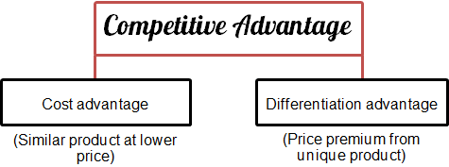

Coca cola’s strategy ?

Slide 4

differentiation
Portfolio: Bring to the world a portfolio of quality beverage brands that anticipate and satisfy people's desires and needs.
להביא לעולם רשימה של מותגי משקה איכותי שממלא את הרצונות והתשוקות של אנשים.
קוקה קולה שואפת לייצר משקאות שנתפסים בעיני הלקוחות כנבדלים באיכותם ועל ידי כך לבדל עצמם מהמתחרים. יש כאן ניסיון לגרום ללקוחות להאמין שיש במוצר מאפיינים בעלי ערך מוסף לעומת המתחרים

Slide 5
differentiation
One of the main goals of the supply chain arm of Coca- Cola is to have every customer receive tailored services from the system, whether that customer is in New York City, Tokyo or a rural area in an isolated part of the world.
Diverse consumers’ and customers’ preferences. “Some customers are primarily take-home for future consumption and some are very immediate consumption, on premise. “Many customers offer a large range of products, so you need packaging at different price points and multi-packs; the portfolio needs to be wide enough to serve all the beverage needs.”

Slide 6
;
differentiation

Slide 7
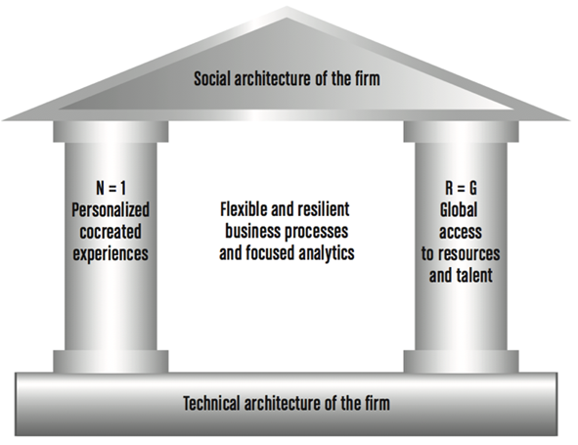
differentiation
Notes:
לצד הגלובליזציה מיזוגים וחברות ענק מתפתחת מגמה הפוכה שמטרתה מתן יחס אישי ללקוח ושימור לקוחות לאורך זמן
התפתחות טכנולוגית מאפשרת למנהלים מירב שליטה ובקרה על הממשקים עם הלקוחות

Slide 8
קוקה קולה שואפת לשרת את כלל השוק ולנצל בכך את היתרון לגודל לטובת עלות נמוכה יחס למתחרים.
cost
Productivity: Be a highly effective, lean and fast-moving organization.

Slide 9
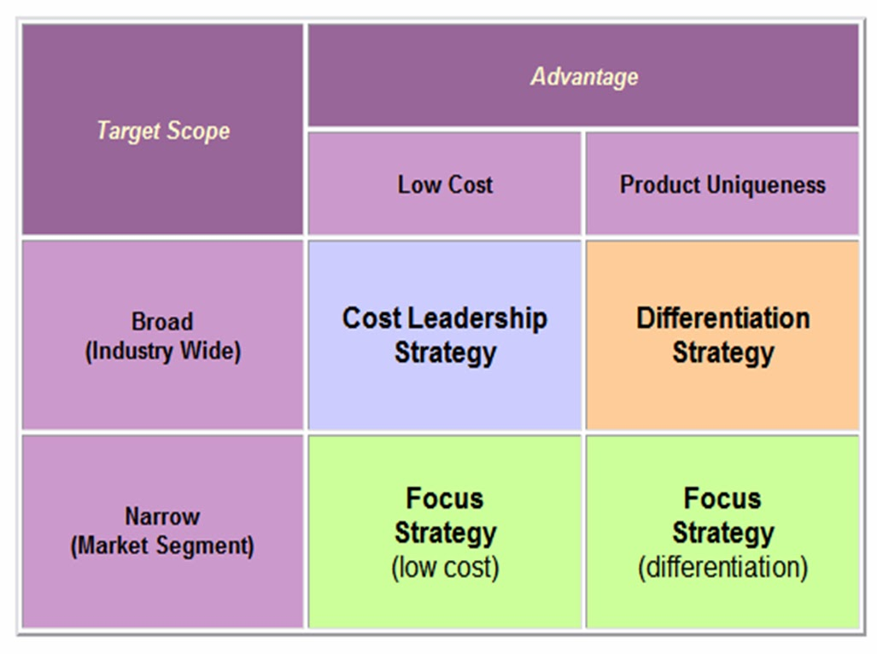

Coca cola’s strategy ?

Slide 10
למרות השאיפה להוביל את שוק המשקאות בעולם קוקה קולה פועלת תוך חלוקת השוק לפלחי שוק שונים
focus

Slide 11
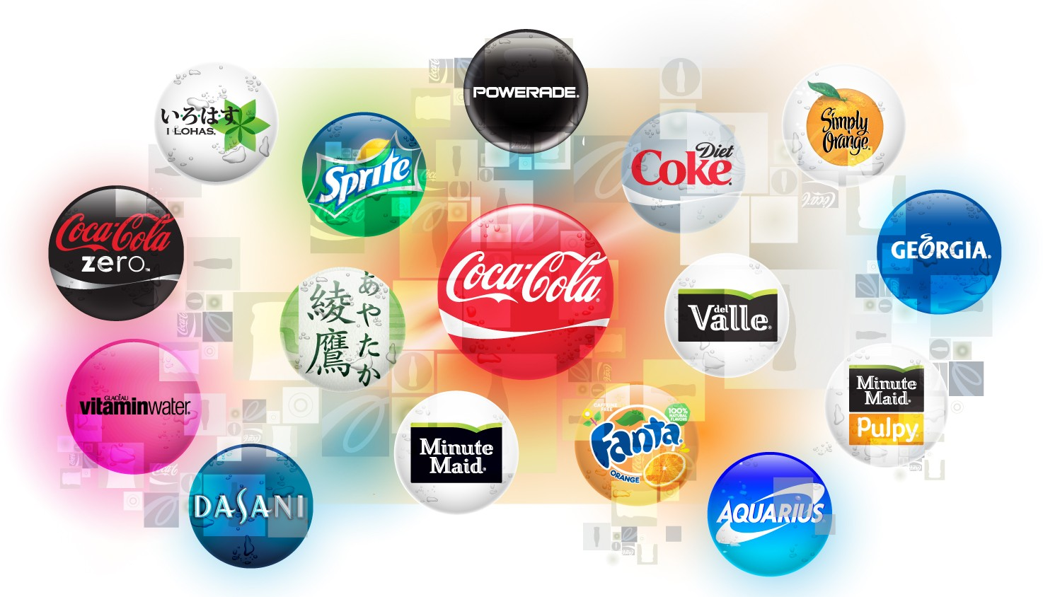

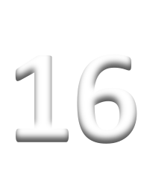



The World’s Greatest Beverage Brands
Focus on needs of our consumers
Company-­‐Owned

Slide 12
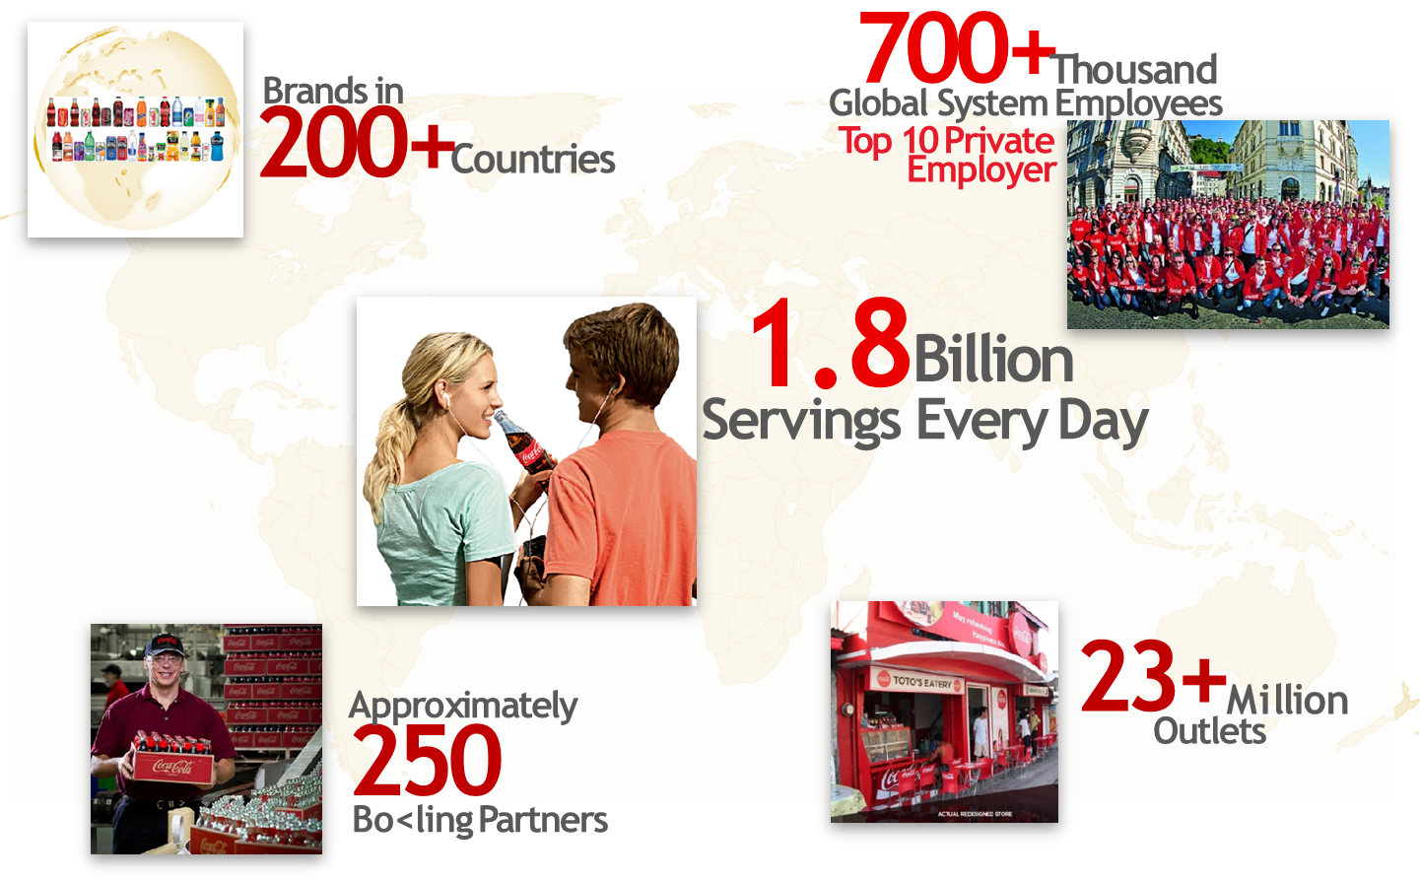

Slide 13
Focus on needs of our consumers
Focus on needs of our consumers, customers and franchise partners
Get out into the market and listen, observe and learn
Possess a world view
Focus on execution in the marketplace every day
Be insatiably curious

Slide 14




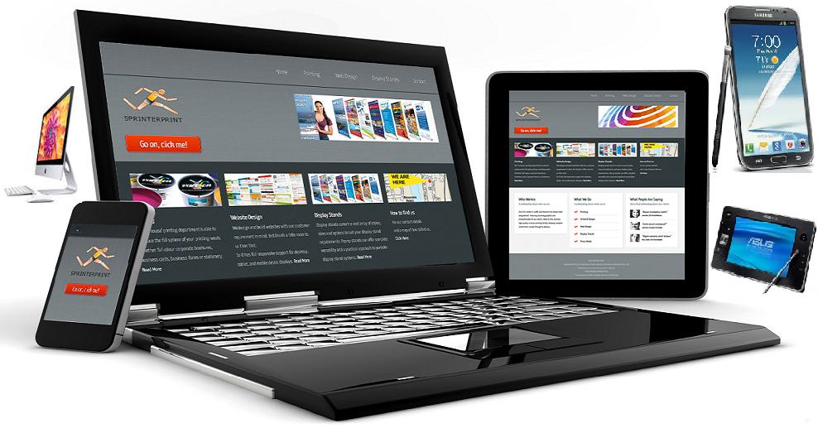
Focus on needs of our consumers

Slide 15
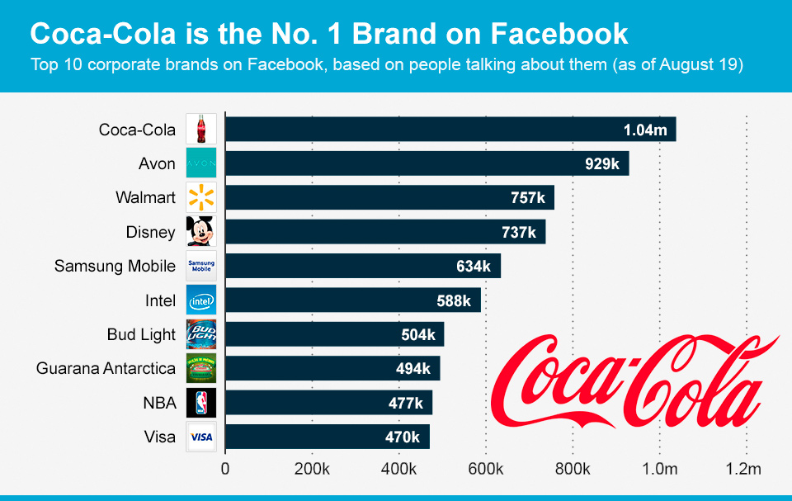
Focus on needs of our consumers

Slide 16


Focus on needs of our consumers

Slide 17

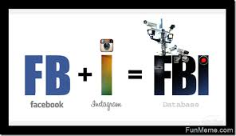

Get out into the market and listen, observe and learn

Slide 18
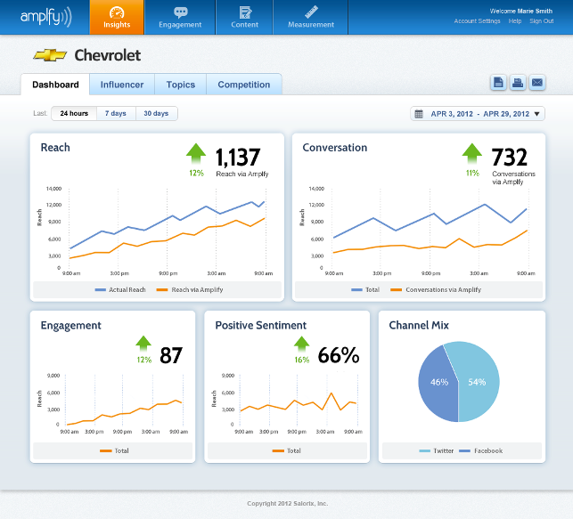
Get out into the market and listen, observe and learn
איסוף מידע, פרסום, שליחת תכנים שיווקיים, ביצוע מיתוג.
זיהוי התגובות החיוביות והשליליות
זיהוי צרכים, מגמות, רעיונות חדשים ליצירת הזדמנויות חדשות
Social media amplification is the concept of taking a positive action such as a purchase or positive review and then sharing it far and wide across our networks

Slide 19
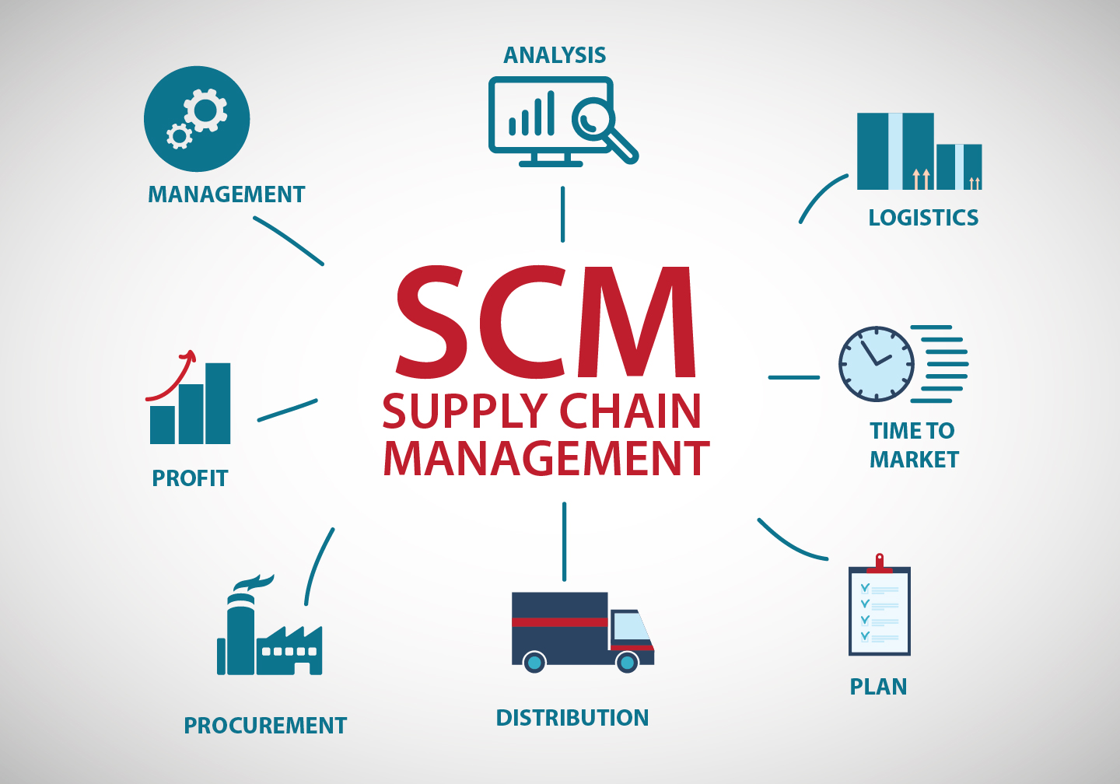
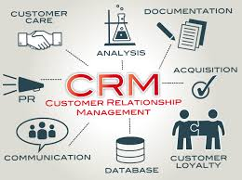
Focus on needs of our customers and franchise partners
“Making sure that every one of its thirsty clients (1.8 billion servings ) gets the right product, at the right time and in the right price range”
Integrating a full database system for sales channel and distributers.
Utilizing a sales driven forecast incorporate with marketing research and business analysis

Slide 20


Focus on needs of our customers and franchise partners
SAP enabled web based platform:
Automated the indirect procurement process.
Transformed the earlier paper based procurement process online.
First - the procurement data is captured in a centralized repository that serves as a reporting source for identifying opportunities and managing risk.
Secondly - key business processes are implemented, automated and standardized to save time and improve accuracy.
Finally - Planning supply is driven by forecasted customer demand input, seasonality and also by promotions or changes in merchandising in the store.

Slide 21
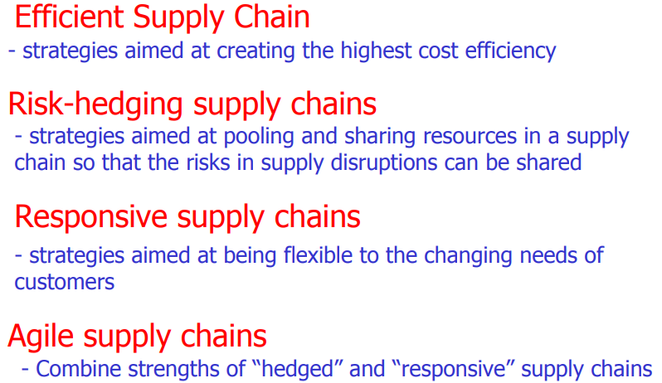
Focus on needs of our customers and franchise partners. However… different types of supply chain
“Segmentation“ - The level of customer care Coca-Cola offers requires a specific model of supply chain structure within local operations
Refrigerated distribution / Ambient
Aseptic filling and packaging which is very specialized and requires different platforms
Some products have high volatility and are hard to forecast, [which requires a different supply chain]

Slide 22
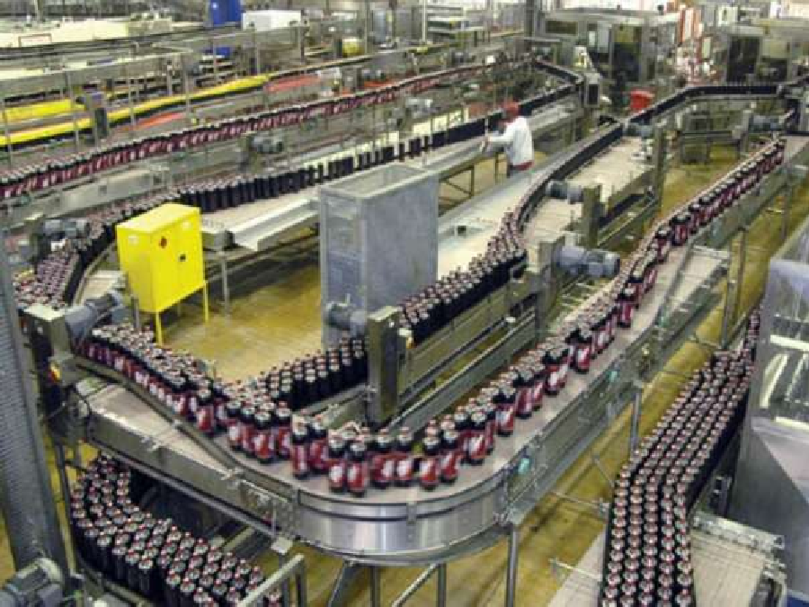
Focus on needs of our customers and franchise partners Examples for key businesses
Incoming materials - Warehouse layout and design to increase efficiency of operations for.
Packaging:
Packaging in bottles and cans.
Introduction of new machinery.
Investment in real time microbiology analyzer.
Returns - Reduce time to send “returns” to suppliers.

Slide 23
Focus on needs of our customers and franchise partners decision support systems
Demand forecasting is used in
making pricing decision
assessing future capacity requirements,
Assessing whether to enter a new market or expand the product market.
Analyzing the total market demand, which capture the total volume that would be bought by a defined consumer group in a defined geographical area, requires real statistical evidence.

Slide 24
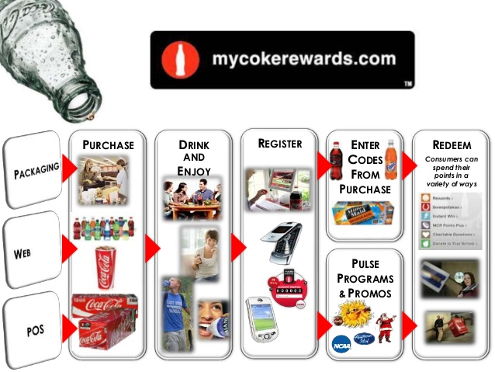
CRM – customer retention

Slide 25
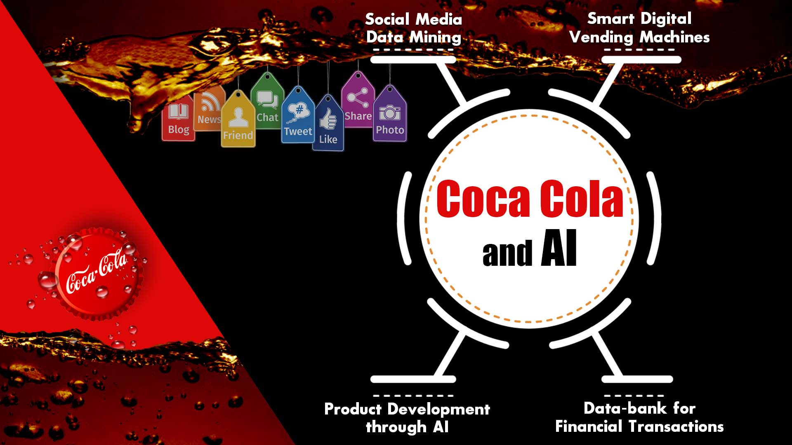
CRM – customer retention research
Data mining:
offers are based on intelligent data mining. Transactional histories record what customers have already bought.
Data mining can tell you the probability of a customer buying any other products (propensity to buy), based on their transactional history or demographic/psychographic profile.

Slide 26
CRM – customer retention research
Reduced RFM scores (Recency-Frequency-Monetary value)
Non-response to a carefully targeted offer
Reduced levels of customer satisfaction
Dissatisfaction with complaint handling
Reduced share of customer
Inbound calls for technical or product-related information
Late payment of an invoice
Querying an invoice
Customer touch points are changed, e.g. store closes, change of website address
Customer change of address

Slide 27
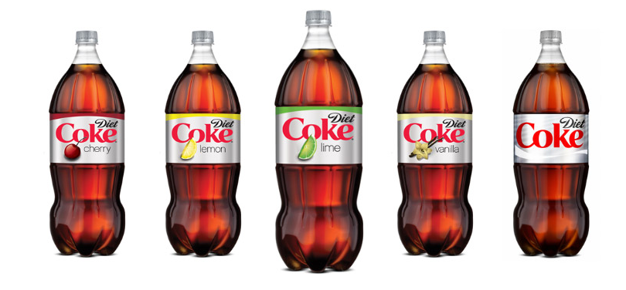
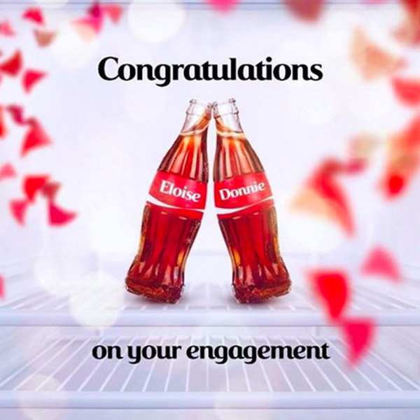
CRM – customer retention research
Customization:
offers are customized at segment or unique customer level.
Also personalized is the communication to the customer and the channel of communication: namely e-mail, surface mail, SMS or phone call.

Slide 28
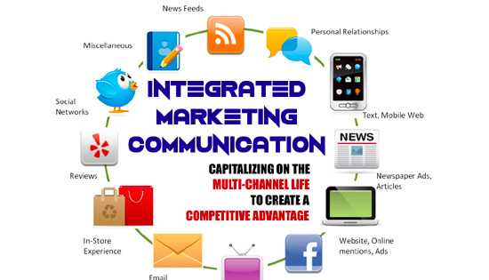
CRM – customer retention research
Channel integration:
customer development activities are integrated across channels.
In retail, channel integration is observed when channels such as store, web and direct to consumer channels act in an integrated, customer-centric manner.

Slide 29
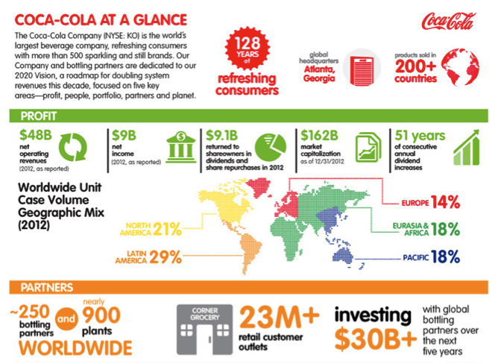
Possess a world view

Slide 30
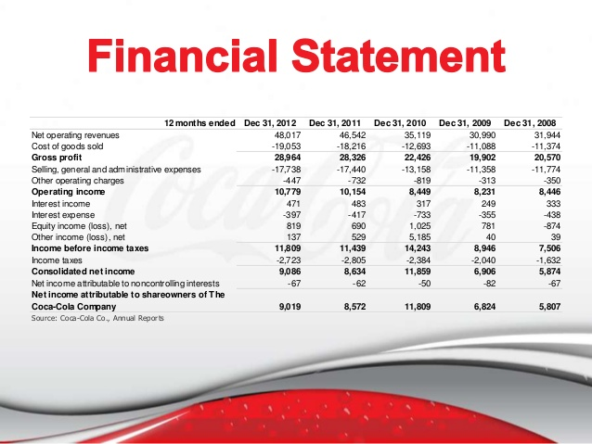
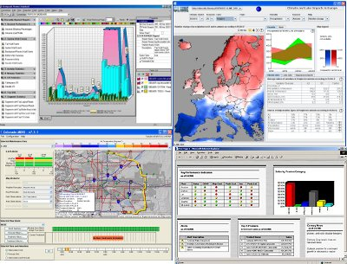
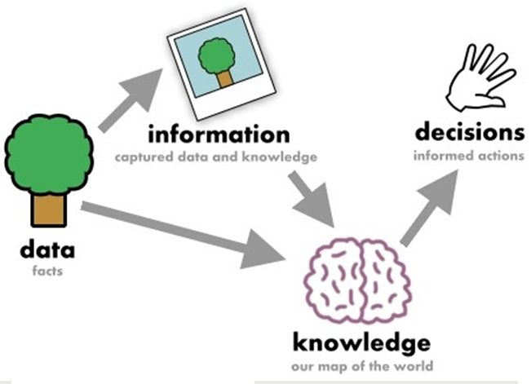
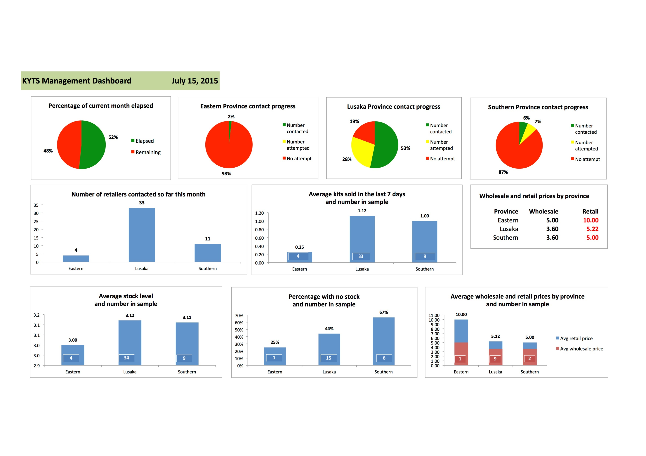

Possess a world view

Slide 31
Possess a world view
“We have 16 million retail outlets around the world that sell Coca-Cola [products], and we have to have common practices, processes and capabilities no matter where we operate in the world,” Buffington explains. “We do direct store delivery to more than 10 million of those [retail outlets]. We make sure we get the product on the shelves in a consistent way from a quality and collaborative standpoint, doing it very efficiently by leveraging our global best practices and building capabilities at the local level.”

Slide 32


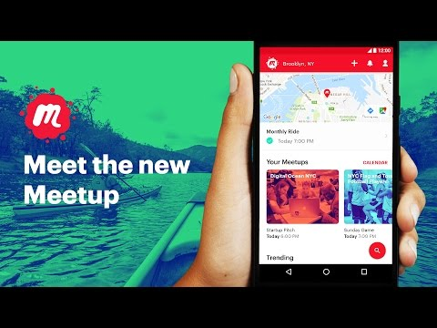
People:
Be a great place to work where people are inspired to be the best they can be.

Slide 33
IT FORCE
Advance the existing the SAP- web based software – EBP by having
In house R &D team.
More functionalities to be added with proper feedback from supplier, vendor etc…
Investment on training to be given to suppliers on operating of the software.
Exploring more business tools to shorten the purchasing process.
Functional within the ERP system to rank suppliers and measure their performance.

Slide 34




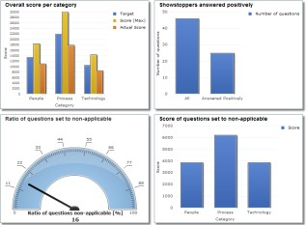

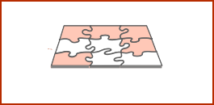


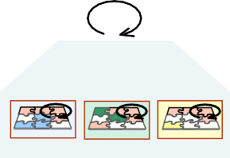








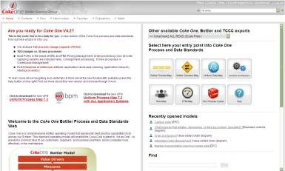
Planning &
Focus on execution in the marketplace every day
Process strategy
BPM governance: BPM strategy, roles, processes
BPM Service offering
Distribution procedures
global rollout management
Continuous improvement
PMM: Process maturity model assessment
Scope definition via UPM (Process list)
Requirements
Analysis
Coke One
Continuous improvement
Bottler I
Bottler II
Bottler III
Design
Process Design Document (PDD) – a mandatory deliverable in Coke One SDLC
Release cycle management
Quality assurance procedures
Business publishing
Build & Test
Test
Solution build based on process design
Synchronization with SAP SolMan
Test case creation based on process (report)
Integration tests based on E2E process definition

Slide 35
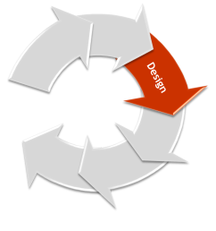
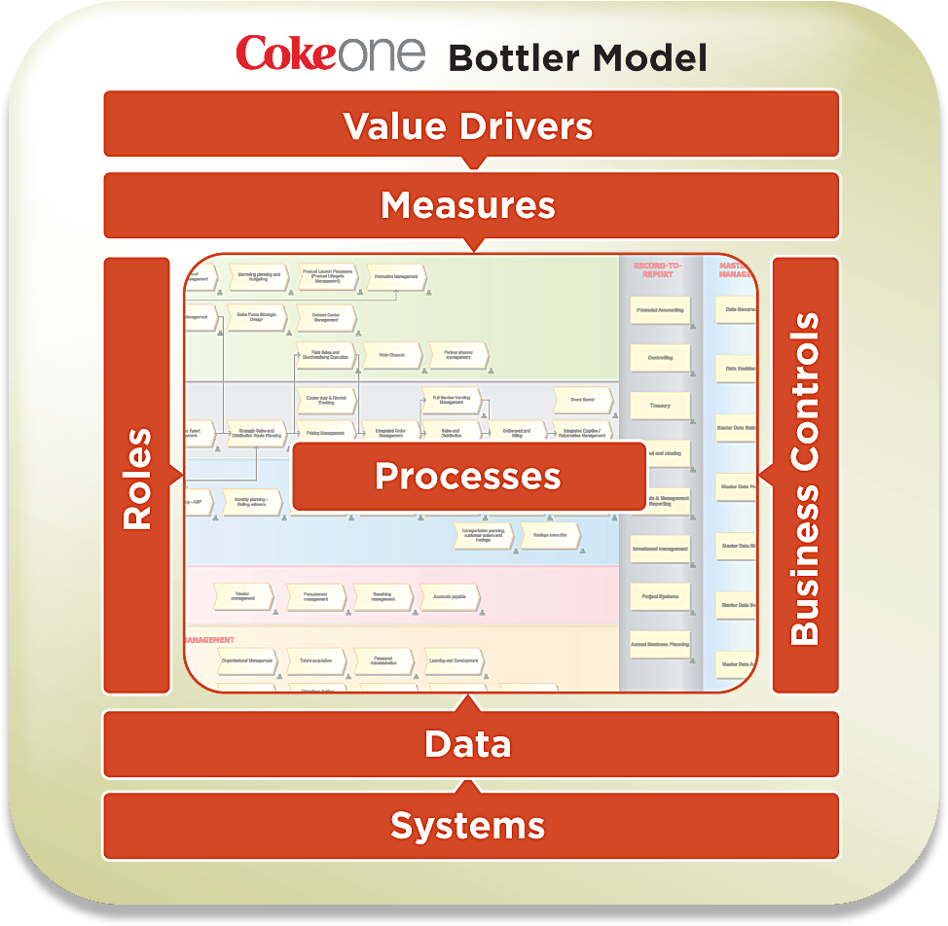
Focus on execution in the marketplace every day
51 KPI / 152 Process performance measures (PPMs) and their relation to Value drivers
Embedded process and measure assessment tools (PMM)
~1080 processes
including 80
variants on 4 levels of detail
~350 Business roles maintained and linked to process steps
125 Risk objects
with 57
automated + 449 manual controls and their relation to processes
~900 SAP transaction codes linked to process steps and 8 Coke One NON SAP application systems

Slide 36

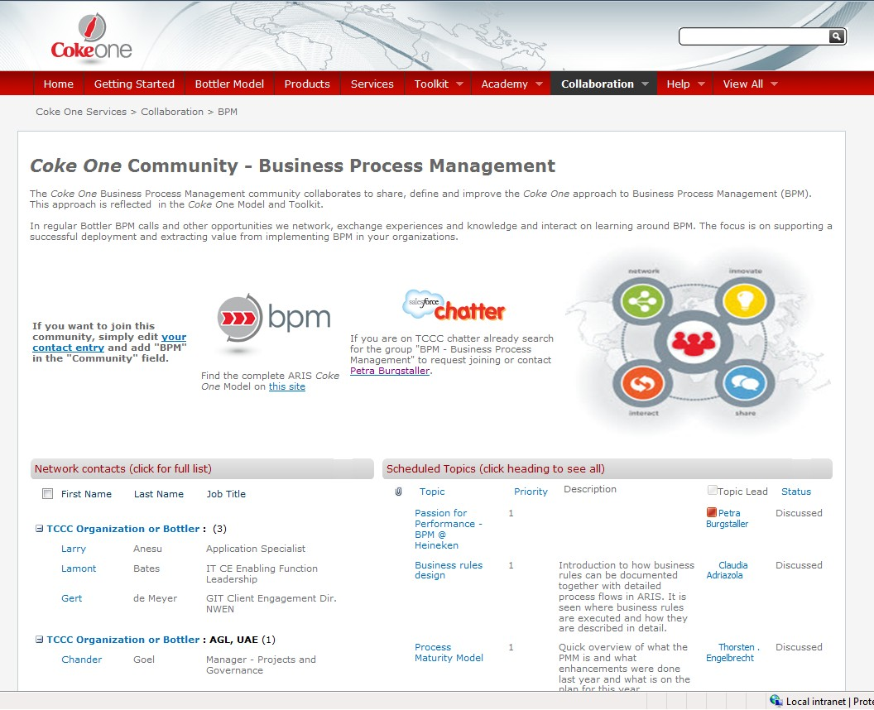


LIVE OUR VALUES – LEADERSHIP VIA BpM
Leadership:
The courage to shape a better future

Slide 37
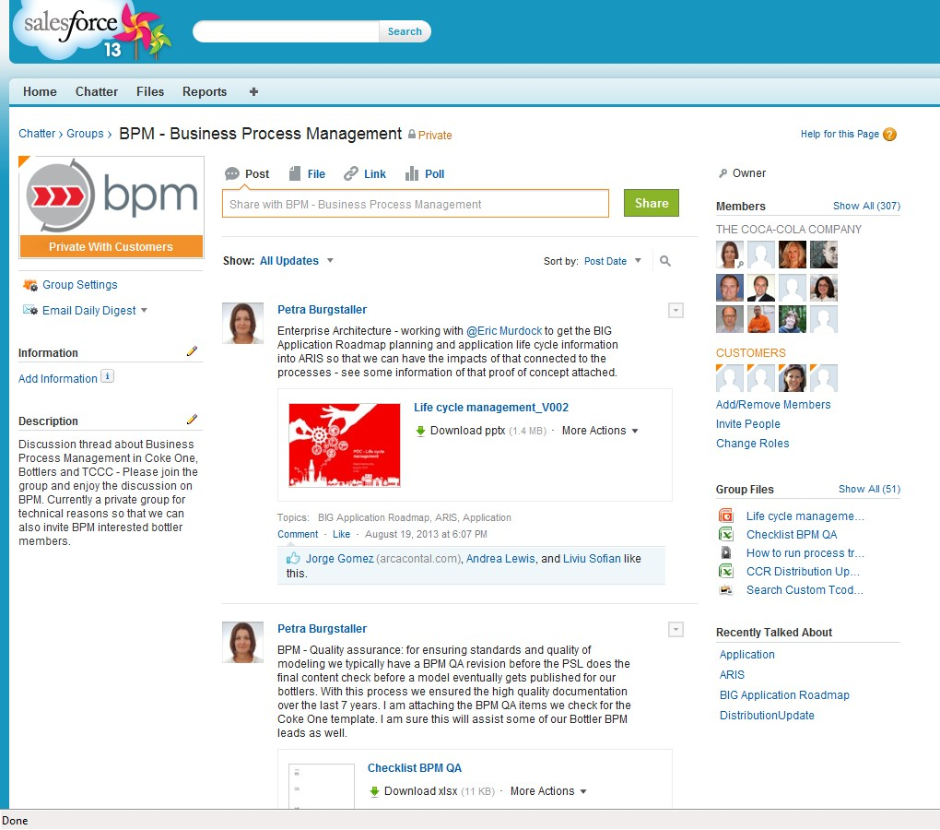
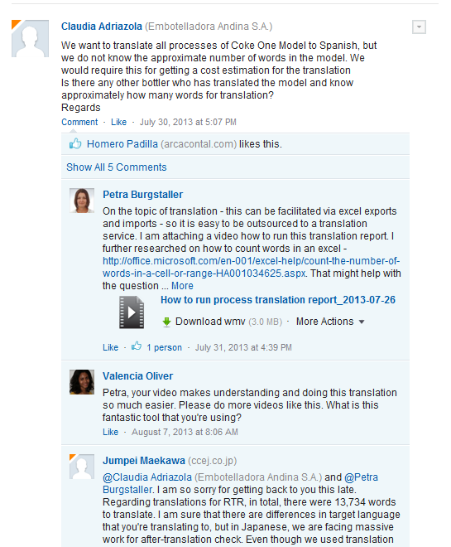


LIVE OUR VALUES - COLLABORATE
Collaboration:
Leverage collective genius

Slide 38
PORTERS FIVE FORCES

Slide 40


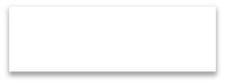


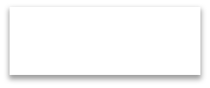

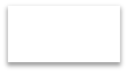









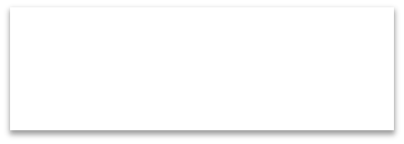
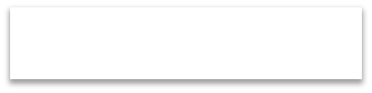
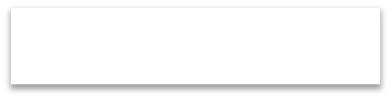





















Organizational Structure
Headquarters
Commercial
Strategic planning
Supply chain
Plan & Integration
Finance
Manufacturing
& Research (Innovations)
Corporate Governance
Delivery Management
Change management
Procurement
Quality & Risk Management
International
Division
Marketing
Manufacturing & Research
Administration
Finance
Sales
Supply
Chain
Area Managers for different plants
Europe
Africa
North/South Americas
Middle & Far east

Slide 41
Work Smart
Act with urgency
Remain responsive to change
Have the courage to change course when needed
Remain constructively discontent
Work efficiently

